Slide 1
Management of tourism companies
For Master’s students
2024-2025
Dr.GOURI M
Faculty of economics-Badji Mokhtar university

Slide 2
CHAPTER 01
Management of tourism companies: concepts

Slide 3
Concepts
Tourisme companies
Firms that provide services for people travelling to places outside their area of residence for less than one consecutive year for leisure, business and other purposes.
These mainly operate in the areas of accommodation, transportation, food and beverage, travel agencies and excursions organizations.

Slide 4
Concepts
Management of tourism companies:
Tourism management refers to handling and supervising activities related to the tourism industry. It is a multifaceted industry that provides people with the training, skills and expertise necessary to obtain management positions in tourism and accommodation.

Slide 5
Concepts
Tourism management is a combination of three aspects:
Business administration processes such as marketing, finance and human resources;
Management principles and concepts;
Topics related to tourism including tourism organisations, environmental aspects and motivation to travel.

Slide 6
Concepts
Tourism management also consists of three business-related components:
Accommodation: Living arrangements in the form of hotels, resorts, cabins, camping areas, homestays and so on;
Accessibility: Transportation and travel arrangements like aeroplanes, cars, trains, public transit, buses and cruises;
Attractions: Tourist attractions such as historical sites, natural resources or theme parks.

Slide 7
CHAPTER 02
Management of travel agencies

Slide 8
1.Travel agencies: Definition
A travel agency is an organization which sells tour packages, arranges for transportation, accommodation, sightseeing and short trips for travelers on behalf of tourism suppliers such as airlines, car rental companies, hotels, railways and cruise ships.

Slide 9
2.Travel agencies: Functions
Provision of Travel Information
Liaison with Providers of Services
Identification of profile of target market
Negotiating for services with principals
Preparation of tour Itineraries
Airline Ticketing
Documentation and foreign exchange procedures
Reservation and Booking
Travel Insurance
Meeting & Incentive planning
Preparation of tour package
costing and pricing of tour package
Tour package Promotion
Actual operation of a Tour Package

Slide 10
CHAPTER 03
Management of tourism offices

Slide 11
1.Tourism offices: Definition
The tourist office is an independent organization that deals with tourism in a region. It is affiliated to the Ministry of Tourism and follows an action plan.
Characteristics:
Autonomy
Specific budget
Tourist activity
General action plan

Slide 12
2.Tourism offices: Differences with Travel agencies
 | Tourism office | Travel agency
Nature of the organism | State organization | private company
Free/paid service | Free services | Paid services
Objective | The objective is the promotion of national tourism | The objective is profitability
Execution | He does not carry out tourist activities by himself, He promotes tourism | He excutes out tourist activities by himself

Slide 13
3.Tourism offices: Place in tourism industry of Algeria
Decentralized services
ONAT
Centralized services
Tourism directions
ONT’
ANDT
TCA
National Tourism Assembly
National commission for the simplification of activities

Slide 14
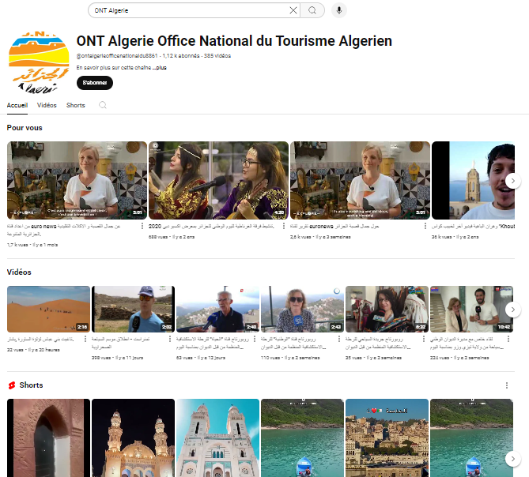

Slide 15
CHAPTER 03
Management of excursion organizations

Slide 16
1. Management of excursion organizations: concepts
Excursion:
An excursion is a dedicated and demonstrative learning process of the surrounding world where prepared objects, theme and itinerary are used and which is done under the supervision of a qualified specialist.

Slide 17
1. Management of excursion organizations: concepts
Excursion service:
Excursion services are the illustrative process of people to learn their environment, natural conditions, organization buildings, laboratory, scientific-research institutions, and other objects.
It has importance as a form of cultural-educational works.

Slide 18
1. Management of excursion organizations: concepts
Itinerary:
it is designed to identify the origin, destination and all the enroute stopping points along with the transportation, accommodation and other services on a traveler’s trip.

Slide 19
2. Management of excursion organizations: Excursion guide skills
• Enough knowledge at expertness
• Analyzing, figurative thinking
• Understanding excursionist’s psychology
• Leading group
• Having a piece of knowledge and practice at pedagogic technique
• Intuition

Slide 20
CHAPTER 05
Management of tourism transportation companies

Slide 21
1.Management of tourism transportation companies: concepts
Transportation:
The word “Tourist Transport” signifies transport provided to a tourist. No tourism activity can take place without Tourist Transport. Admittedly every tourist has to move from place to place and needs transportation for his or her movement. There are various types of transport available for a tourist, namely, Railways, Air, Motor Vehicle and Water Transport.

Slide 22
1.Management of tourism transportation companies: concepts
Role:
In today’s industrial society, the time at the disposal of tourist is very limited. A leisure tourist may have only a few weeks while the business tourist can afford to spend only a few days.
Consumer psychology is as present in tourist industry as in any other service industry and thus the tourists like to maximise the returns of their spendings by covering in their itinerary as many places as possible within the limited timeframe.
All this can only be ensured by transport.

Slide 23
2.Management of tourism transportation companies: means of transportation
ROAD TRANSPORT
-Is suitable for short and medium distances.
-It offers a number of advantages such as flexibility, reliability, speed and door-to-door service, besides supplementing and increasing the efficiency of the other modes of transport.
-Within Road Transport there are different modes like tourist coaches, buses, taxis of various types. These modes of Road Transport provide access to millions of people by using National highways, state highways, district roads, village roads or even unclassified village roads.

Slide 24
2.Management of tourism transportation companies: means of transportation
RAIL TRANSPORT
The National Railway Transport Company (SNTF) (in Arabic: الشركة الوطنية للنقل بالسكك الحديدية) is the Algerian public railway company created in 1976, it is particularly present in the fields of passenger transport, freight transport and carries out management, the operation and maintenance of the Algerian railway network of which it is the owner.
By its volume of activity and the size of its network, SNTF is the second largest railway company in Africa after the South African Railways.

Slide 25
2.Management of tourism transportation companies: means of transportation
AIR TRANSPORT
The country has 36 airports open to air traffic, including 20 international airports.
Three Airport Services Management (EGSA) establishments based: in Algiers, Constantine and Oran, they manage all national airports.
Algiers Airport: the opening of the new western terminal in April 2019 increases the annual capacity of the capital's airport to 21 million passengers per year.

Slide 26
CHAPTER 06
Tourism tickets

Slide 27
1. Tourism tickets: Concepts
Airline Ticketing:
It is a document issued by the travel agencies that provides the seat in the particular aircraft to the passenger.
During an earlier period of time, the printed ticket on a piece of paper was used.
Now an electronic type of tickets is used, which is also called as
E-ticket.

Slide 28
1. Tourism tickets: Concepts
Class | Types of ticket
Economy class | Cheaper, the passengers are not offered any specific meal, the seats are not comfortable
First-class | Very comfortable seats with extra leg space. The quality of meals.
Child tickets | If the child is less than two years, he will sit on his guardian's lap. If a child is more than two years ago, the guardians have to purchase the ticket for his child.
Round-trip tickets | The passengers shall start the journey from the specific destinations and will come back to origin of destination only. The ticket is cheaper than a one way.
One-way airline | The passenger shall be purchasing the ticket for the onward journey only., and has to buy another ticket if he wishes to travel at other destinations.
Refundable | It makes eligible to the passenger for a refund, if he doesn’t cancel his trip.
Non-Refundable | The passenger shall not be getting any refund in case of any changes

Slide 29
2. Tourism tickets: Reservation
Definition of reservation:
The word Reservation in the Travel industry is used for blocking of the seats or accommodation in the hotels, without completing the process of buying actually.
The airline industry it refers to block the seats on a request of the passenger, while reservations process the reservationist need the details of the passenger like name of the passenger, age, destination, date and time of travel and other necessary information shall be taken into account.

Slide 30
CHAPTER 07
Tourism insurance

Slide 31
1.Tourism insurance: Definition
Travel insurance is a set of insurance and assistance services to cover unforeseen costs that every traveler may have to face. It designates all the services associated with the risks incurred during travel. It includes non-life insurance guarantees such as loss of baggage or cancellation. Global population growth and the free movement of people increase the risk of accidents and the risk of lost luggage.

Slide 32
2.Tourism insurance: Products
Baggage cover Trip delay Cancel for any reason Evacuation Flight Accident insurance Travel insurance Trip cancellation coverage Trip cancellation Baggage delay | Accidental death and dismemberment Emergency medical evacuation and repatriation Collision damage Waiver Comprehensive travel insurance Coverage includes pre-existing illnesses Emergency medical and dental benefits Medical tourism

Slide 33
CHAPTER 08
Distribution and communication

Slide 34
I.Distribution

Slide 35
1.Distribution: Definition
Distribution is essentially a two-step process, which consists of giving information to the right person, in the right place and at the right time, enabling them to make their purchasing decision, as well as set up the tools allowing the customer to reserve and pay for the requested product.
The perishable nature of travel products and the complexity of certain tourist services make distribution a major challenge.
Selling all fixed capacity and related services every day at the optimal price is the key to profitability for tourist structures.

Slide 36
2.Distribution: Networks
Network Structure:
Producer
Intermediate
Client

Slide 37
II. Communication

Slide 38
1.Communication: promotional mix
The promotional mix describes a blend of promotional variables chosen by marketers to help a firm reach its goals. In fact, promotional mix is widely used as a subset of the marketing mix.
Elements of promotion mix
Advertising
Sales promotion
Personl selling
Public relations
Direct marketing

Slide 39
2.Communication: Strategies
The Pull & Push strategy
Corporate and business strategy
Mass and relationship strategy
Media and non-media strategy

Slide 40
3. Communication: Plan
Determine the target
Fixe objectives
Formulate the message
Choose the communication channel
Fixe the budget
Determine the promotional mix
Measure the results

Slide 41
CHAPTER 09
Regulatory requirements
in travel

Slide 42
Regulatory requirements in travel
Legal requirements
Financial requirements
Technolgy requirements
Sanitary requirements

Slide 43
CHAPTER 10
International tourism organizations

Slide 44
International tourism organizations
World Tourism Organization UNWTO
World Travel & Tourism Council WTTC
IATA Business Intelligence and Statistics
International Social Tourism Organisation ISTO

Slide 45
Thank’s
meriem.gouri@univ-annaba.dz @gmail.com

