Slide 1
Balance Cheet
Prepared by the students:
IDDIR SOULEF.
AMIROUCHE BOUTHEINA.
BROUM YOUSRA.
BASSI AMINA.
LARABI NOUR AL-HOUDA.
Group 03
2025-2024

Slide 2
Research Plan
Definitions
Key elements & components of a balance sheet:
General sequence of accounts in a balance sheet:
Balance sheet formula & equation
Conclusion

Slide 3
Definitions
A balance sheet is a key financial statement that shows a company’s assets and liabilities at a specific time and helps assess its financial performance.
A balance sheet helps investors and stakeholders assess a company’s financial health, liquidity, and growth by comparing assets, liabilities, and performance over time.
The balance sheet helps stakeholders evaluate a company's future prospects and creditworthiness by showing its ability to meet short-term obligations and manage financial risk.

Slide 4
Balance sheet example with sample format:

Slide 5
Key elements & components of a balance sheet:
Assets
Liabilities
a. Convertibility
Current assets:
Fixed assets:
Current liabilities
b. Physical existence:
Tangible assets:
Intangible assets:
Non-current liabilities
c. Usage:
Operating assets:
Non-operating assets

Slide 6
Owner’s Equity/ Earnings
Owner’s equity is the company’s net value, calculated by subtracting liabilities from assets. It includes retained earnings and can be positive or negative, showing whether assets cover liabilities.

Slide 7
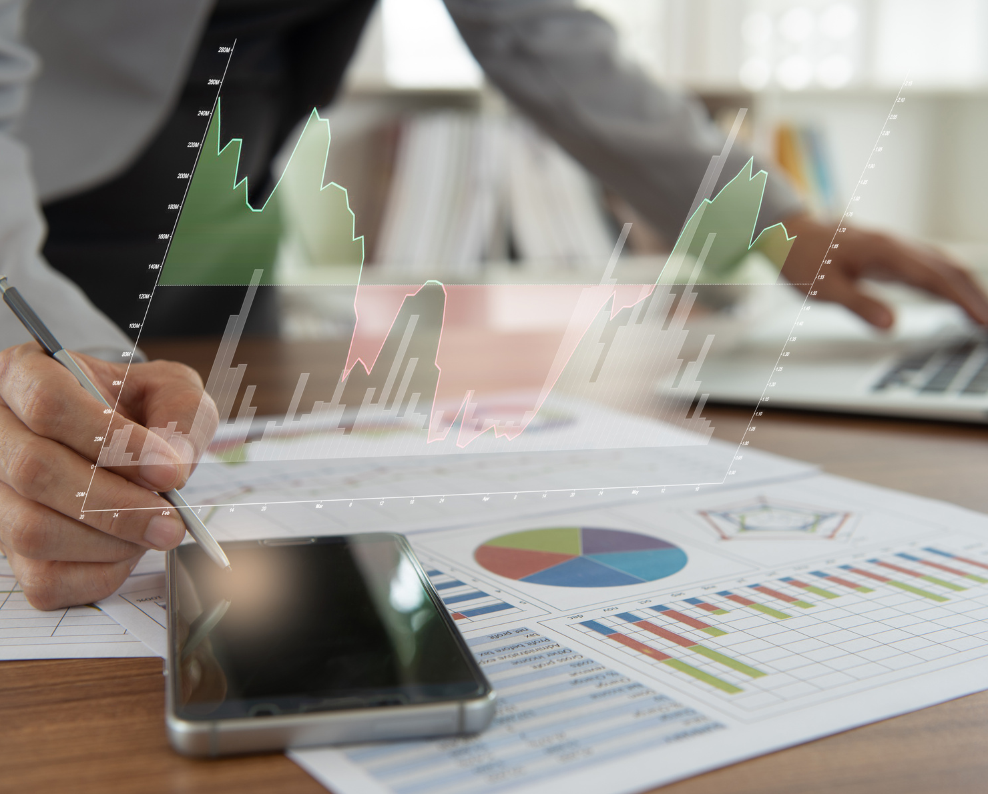
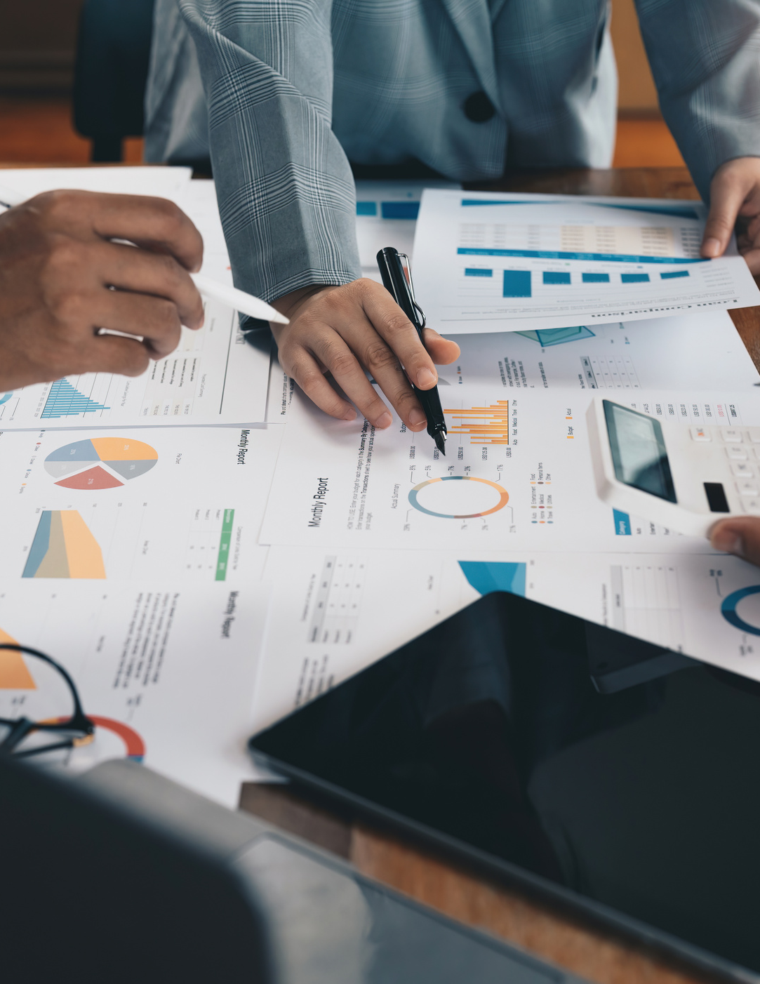
General sequence of accounts in a balance sheet:
The paragraph explains how, according to GAAP, assets and liabilities must be categorized and presented separately. Current assets (like cash and inventory) are listed in order of liquidity, and current liabilities (like salaries and interest payable) are separated from long-term liabilities (like bonds payable). Shareholders' equity is listed in decreasing order of priority.
02
03

Slide 8
Balance sheet formula & equation
Shareholder’s Equity
Assets
Liabilities

Slide 9
Conclusion
A balance sheet is an important reference document for investors and stakeholders for assessing a company’s financial status. This document gives detailed information about the assets and liabilities for a given time. Using these details one can understand about company’s performance. By analysing balance sheet, company owners can keep their business on a good financial footing.

Slide 10
Thank You

