Slide 1
Depreciation and Amortization
Presented by:meeki arcelene-chouakria kais-guedri abdeljalil-sayoud abde raouf-bouhouche akrem-guerri youssri-laiche ahmed yacine-boughazi med islem-

Slide 2
Research plan
Introduction
Part 1: Definition of Depreciation
Part 2: Methods of Depreciation
Part 3: Definition of Amortization
Part 4: Accounting Treatment
Part 5: Real-World Examples
Part 6: Importance and Benefits
Part 7: Challenges and Considerations
Conclusion

Slide 3
Introduction
Businesses use both tangible and intangible assets to generate revenue. Over time, these assets lose value due to use, time, or obsolescence. To reflect this in financial statements, two main accounting concepts are used:
- Depreciation (for tangible assets)
- Amortization (for intangible assets)
These methods ensure expenses are allocated over the useful life of assets.

Slide 4
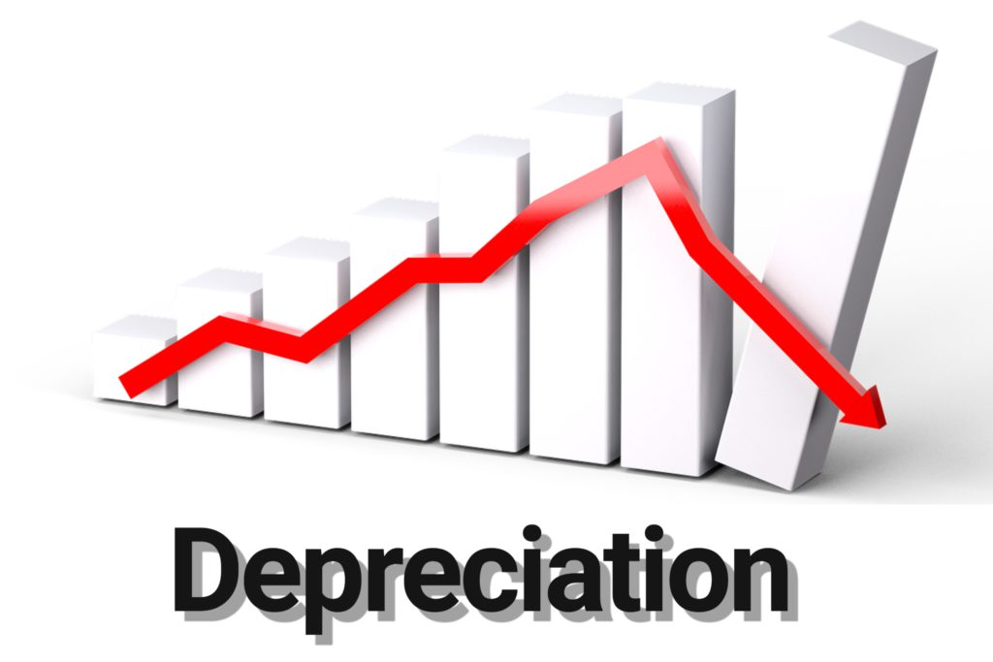
Part 1: Definition of Depreciation
Depreciation is the allocation of the cost of a tangible fixed asset over its useful life.
It reflects the decrease in value due to:
- Wear and tear
- Usage
- Obsolescence
Examples of depreciable assets:
- Vehicles
- Machinery
- Equipment
- Buildings

Slide 5
Part 2: Methods of Depreciation
1. Straight-Line Method:
- (Cost - Residual Value) / Useful Life
- Simple and consistent
2. Declining Balance Method:
- Accelerated method
- Higher depreciation in early years
3. Double Declining Balance:
- Twice the straight-line rate
4. Units of Production:
- Based on usage or output, ideal for machinery

Slide 6
Part 3: Definition of Amortization
Amortization is similar to depreciation but applies to intangible assets.
It allocates the cost of an intangible asset over its useful life.
Usually uses straight-line method.
Residual value is generally not considered.
Examples:
- Patents
- Copyrights
- Software licenses
- Trademarks

Slide 7
Part 4: Accounting Treatment
Depreciation and amortization are recorded as non-cash expenses on the income statement.
- They reduce the value of assets on the balance sheet.
- Accumulated depreciation/amortization accounts show total reduction.
- Help match expenses to revenues in the same accounting period.

Slide 8
Part 5: Real-World Examples
- A truck bought for $50,000, depreciated over 5 years using straight-line method.
- A software license for $9,000 amortized over 3 years.
- A patent costing $20,000 amortized over its 10-year legal life.
Each example spreads the asset cost across the useful period, impacting annual profit.

Slide 9
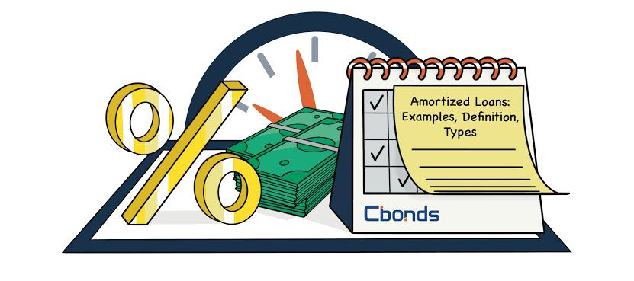
Part 6: Importance and Benefits
- Reflects true asset value over time.
- Improves financial transparency and accuracy.
- Ensures compliance with accounting standards (IFRS, GAAP).
- Helps companies plan for asset replacement and capital investment.
- Affects tax calculations and net income.

Slide 10
Part 7: Challenges and Considerations
- Estimating useful life and residual value can be subjective.
- Different methods affect financial outcomes.
- Requires consistent application for comparability.
- May impact investor perception if changes are made in estimation.

Slide 11
Conclusion
Depreciation and amortization are essential tools in financial accounting.
They ensure expenses are spread across the periods that benefit from asset use.
Proper use leads to accurate reporting, better financial management, and informed decisions.

