Slide 1

مقدمة في علم البيانات وتعلم الآلة (Introduction to Data Science and Machine Learning) الأستاذ: بن معزو محمد زكريا

Slide 2
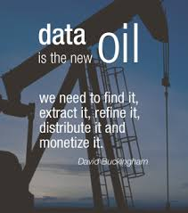

Slide 3
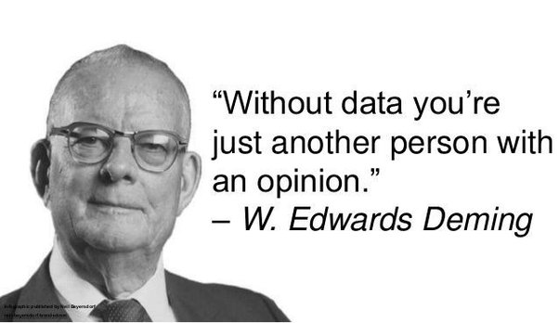

Slide 4
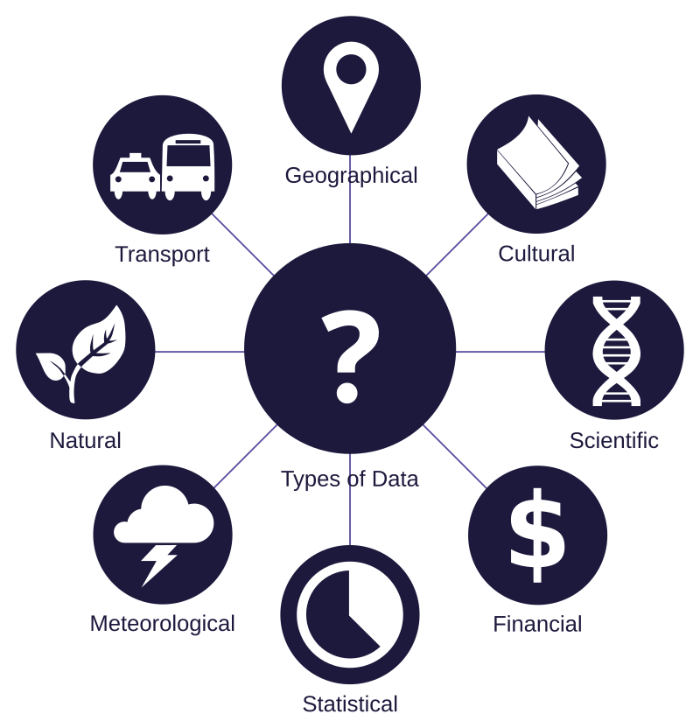
Definition of Data
Data are a collection of discrete or continuous values that convey information, describing the quantity, quality, fact, statistics, other basic units of meaning, or simply sequences of symbols that may be further interpreted formally.
A datum is an individual value in a collection of data.
Data are usually organized into structures such as tables that provide additional context and meaning, and may themselves be used as data in larger structures.
Data may be used as variables in a computational process. Data may represent abstract ideas or concrete measurements.
Data are commonly used in scientific research, economics, and virtually every other form of human organizational activity. Examples of data sets include price indices (such as the consumer price index), unemployment rates, literacy rates, and census data. In this context, data represent the raw facts and figures from which useful information can be extracted.

Slide 5

Data Science

Slide 6



Etymology of the term
The term "data science" has been traced back to 1974, when Peter Naur proposed it as an alternative name to computer science.
In 1997, C. F. Jeff Wu suggested that statistics should be renamed data science.
In 1998, Hayashi Chikio argued for data science as a new, interdisciplinary concept, with three aspects: data design, collection, and analysis.

Slide 7
Definition of data science
Data science is an interdisciplinary academic field that uses statistics, scientific computing, scientific methods, processing, scientific visualization, algorithms and systems to extract or extrapolate knowledge from potentially noisy, structured, or unstructured data.
A data scientist is a professional who creates programming code and combines it with statistical knowledge to summarize data.

Slide 8
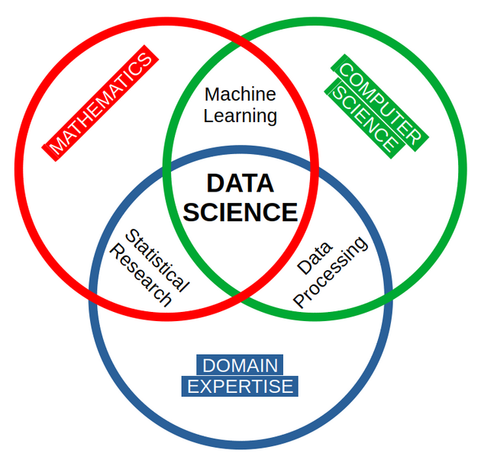

Slide 9
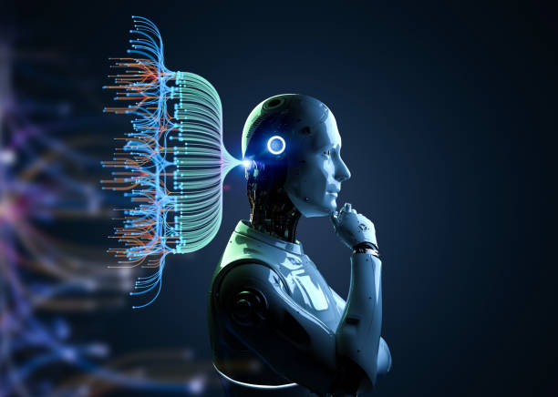
Machine Learning (ML)

Slide 10
Definition of Machine Learning (ML)
Machine learning (ML) is a field of study in artificial intelligence concerned with the development and study of statistical algorithms that can learn from data and generalise to unseen data.
ML finds application in many fields, including natural language processing, computer vision, speech recognition, email filtering, agriculture, and medicine. The application of ML to business problems is known as predictive analytics.

Slide 11
Types of ML
Machine learning approaches are traditionally divided into three broad categories, which correspond to learning paradigms, depending on the nature of the "signal" or "feedback" available to the learning system:

Slide 12
Supervised learning: The computer is presented with example inputs and their desired outputs, given by a "teacher", and the goal is to learn a general rule that maps inputs to outputs.
Unsupervised learning: No labels are given to the learning algorithm, leaving it on its own to find structure in its input. Unsupervised learning can be a goal in itself (discovering hidden patterns in data).
Reinforcement learning: A computer program interacts with a dynamic environment in which it must perform a certain goal (such as driving a vehicle or playing a game against an opponent). As it navigates its problem space, the program is provided feedback that's analogous to rewards, which it tries to maximise.

Slide 13
